Slide 1


EARTHQUAKE PREDICTION MODEL USING PYTHON
TEAM
ASHMI W SHARON
ASLIN SELJA V
ASHLIN JESHMA S J
CHRISTALIN SHEMY C
ASHMA S B
This Photo by Unknown Author is licensed under CC BY

Slide 2

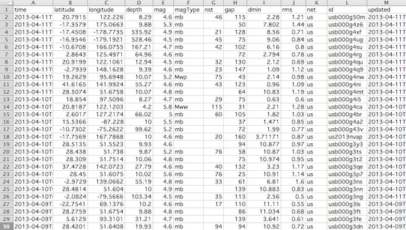
DATASET FOR EARTHQUAKE

Slide 3

SAMPLE CODE
import numpy as np
import pandas as pd
from sklearn.model_selection import train_test_split
import pickle
from sklearn import metrics
from sklearn.ensemble import RandomForestClassifier
data = pd.read_csv("dataset.csv")
data = np.array(data)
print(data)
X = data[:, 0:-1]
y = data[:, -1] y = y.astype('int')
X = X.astype('int')
X_train, X_test, y_train, y_test = train_test_split(X, y, test_size=0.2, random_state=0)
print(X_train,y_train)
rfc = RandomForestClassifier()
rfc.fit(X_train, y_train)
y_pred = rfc.predict(X_test)
print(metrics.accuracy_score(y_test, y_pred))

Slide 4

Project Prerequisites
The requirement for this project is Python 3.6 installed on your computer. I have used Jupyter notebook for this project. You can use whatever you want.
The required modules for this project are –
Numpy(1.22.4) – pip install numpy
Sklearn(1.1.1) – pip install sklearn
Pandas(1.5.0) – pip install pandas
That’s all we need for our earthquake prediction project.

Slide 5
Steps for creating a earthquake prediction model
Preprocessing of Dataset.
Splitting the Datasets.
Building ML models such as Linear Regression, Decision Tree and KNN.
Visualization with Matplotlib and Seaborn.
Prediction.

Slide 6
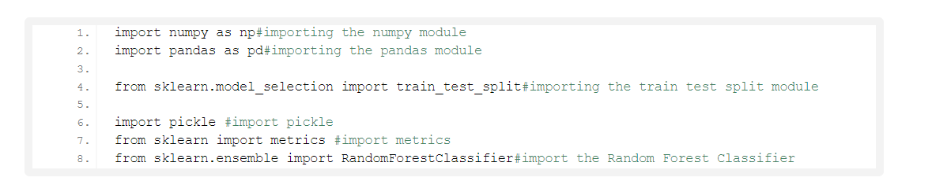
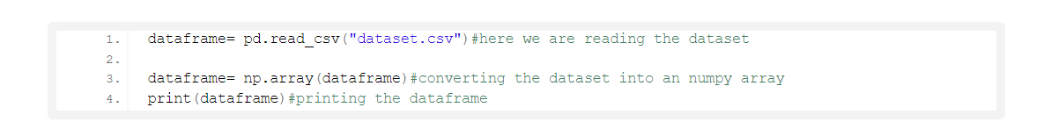
Earthquake Prediction Project
Steps to Implement
1. Import the modules and all the libraries we would require in this project.
2. Here we are reading the dataset and we are creating a function to do some data processing on our dataset. Here we are using the numpy to convert the data into an array.

Slide 7
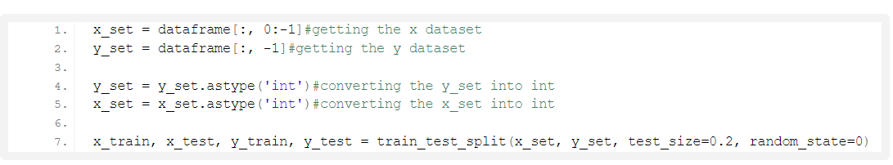
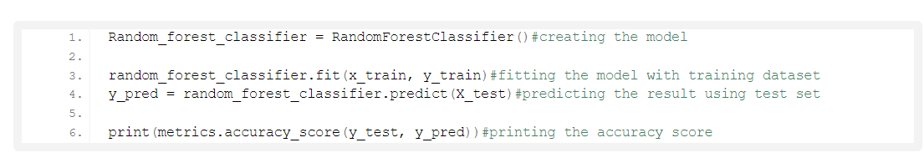
3. Here we are dividing our dataset into X and Y where x is the independent variable whereas y is the dependent variable. Then we are using the test train split function to divide the X and Y into training and testing datasets. We are taking the percentage of 80 and 20% for training and testing respectively.
4. Here we are creating our RandomForestClassifier and we are passing our training dataset to our model to train it. Also then we are passing our testing dataset to predict the dataset.

Slide 8
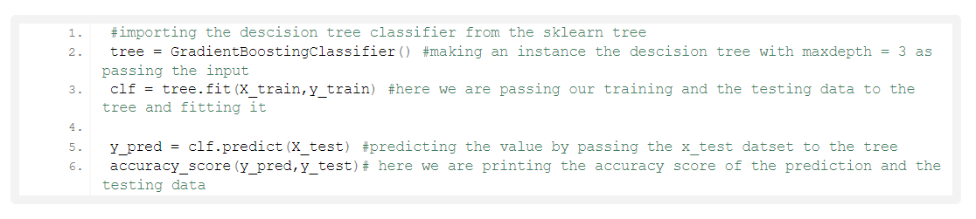
5. In this piece of code, we are creating our instance for Gradient Boosting Classifier. The maximum Depth of this Gradient Boosting algorithm is 3. After creating the instance, we pass our training data to the classifier to fit our training data into the algorithm. This is a part of training.
Once we are done with training, we pass the testing data, and we make our predictions on testing data and store it in another variable. After training and testing, it’s time to print the score. For this, we are using the accuracy score function, and we are passing the predicted values and the original values to the function, and it is printing the accuracy.

Slide 9
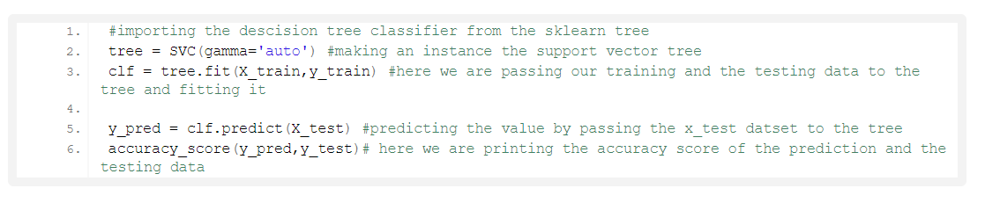
6. Here, we are doing the same thing as above. The only difference is that this time, we are using Support Vector Classifier. So, we are creating an instance of Support Vector Classifier and setting the gamma function to “auto”. After that, we pass the training data to the classifier.
After training the model, we pass the testing data to our model and predict the accuracy score using the accuracy score function.

Slide 10
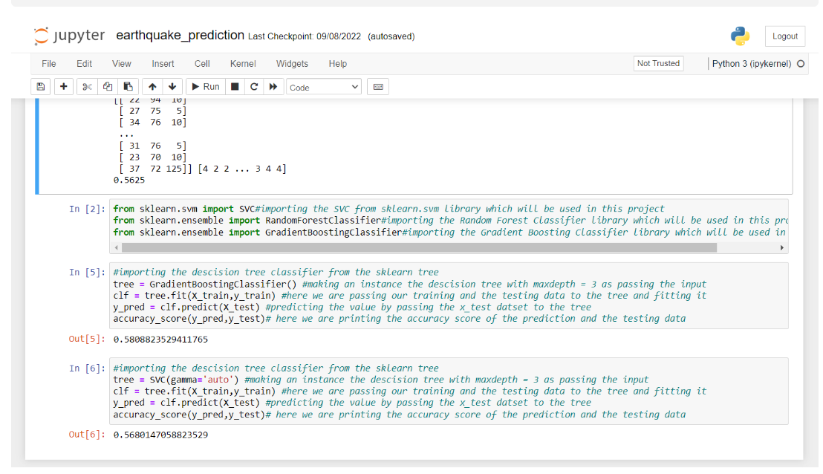

Slide 11
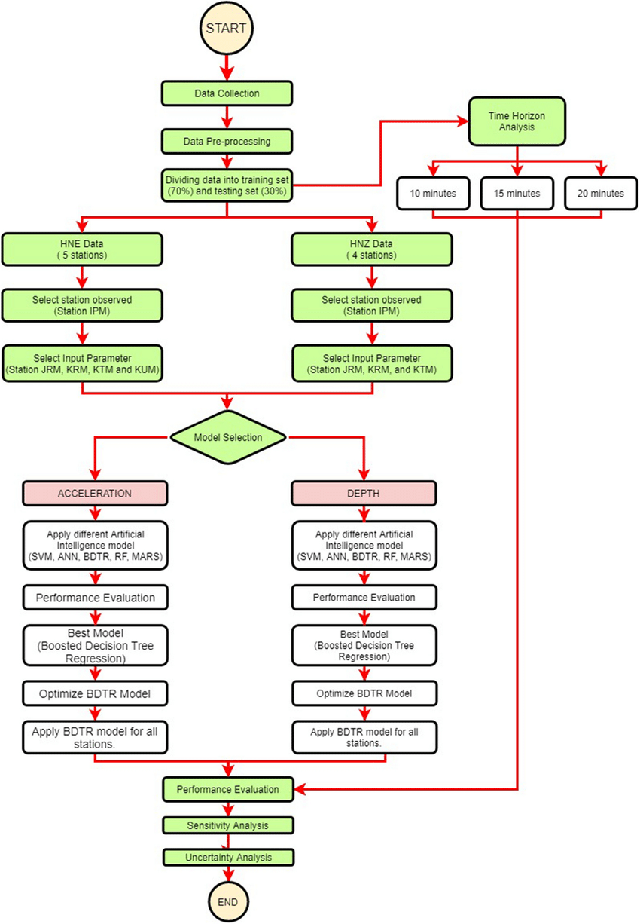
Flowchart for creating a earthquake prediction

Slide 12

CONCLUSION
In this Machine Learning project,
we built an earthquake prediction system.
In this project, we used
Random Forest Classifier, SVC,
and Gradient Boosting algorithm
in this project.

Slide 13
THANK YOU

